Slide 1
CE313 COMPUTER COMMUNICATIONS & COMPUTER NETWORKS

Slide 2
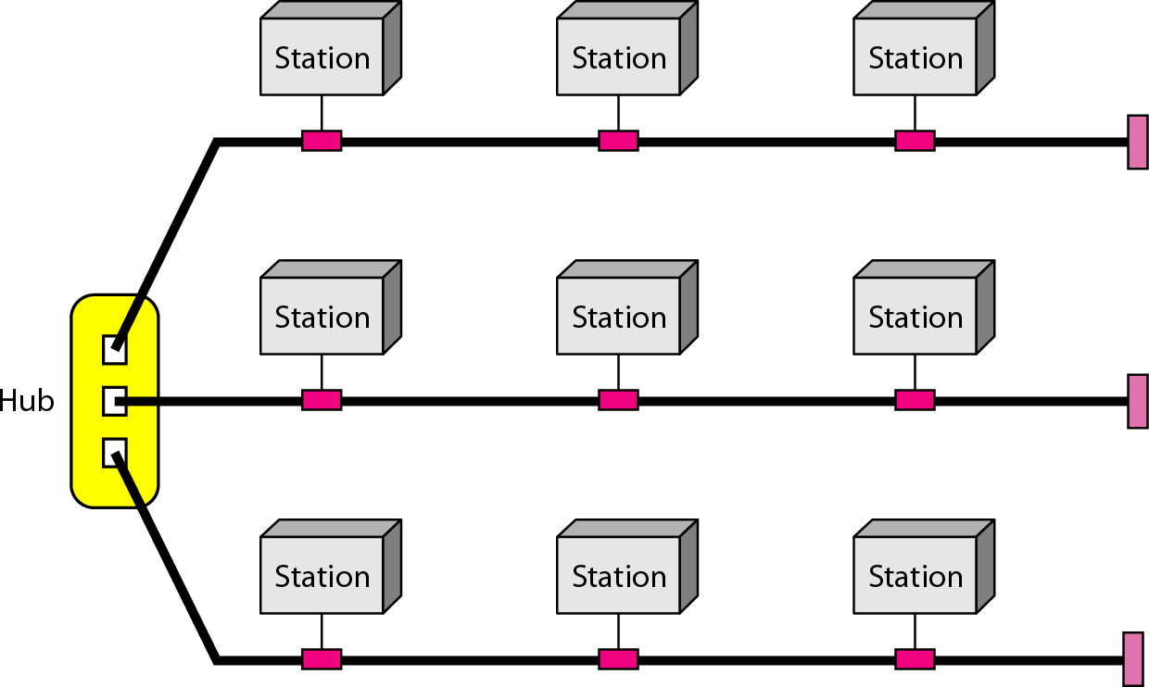
HYBRID TOPOLGY

Slide 3
CATEGORIES OF NETWORK
Network
Local area network (LAN)
Metropolitan area network (MAN)
Wide area network (WAN)

Slide 4
LOCAL AREA NETWORK
Usually privately owned and links the devices in a single office, building or campus.
Geographical size is few kilometers.
Designed to allow resources (hardware, software or data) to be shared between personal computers or work stations.
In general use one type of media.
Topologies: bus, ring and star.
Data rates: 4 to 16 Mbps. Recent advancements support up to 100 Mbps and Gbps is in development.

Slide 5
Question
Which topology is LEAST common in modern LANs? A) Star B) Bus C) Mesh D) Ring

Slide 6
Question
Which topology is LEAST common in modern LANs?
A) Star ✅ (Most common today) B) Bus ❌ (Legacy Ethernet) C) Mesh ❌ (Rare due to cost) D) Ring ❌ (Token Ring obsolete)

Slide 7
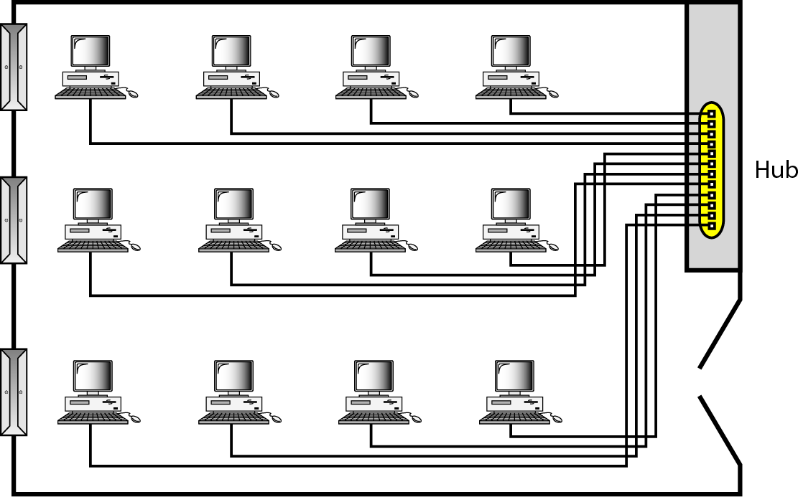
LAN connecting 12 computers in a Hub

Slide 8
METROPOLITAN AREA NETWORK
Designed for the customers who need a high speed connectivity, normally to the internet and spread over a city or part of city.
Maybe a single network or maybe a means of connecting number of LANs into a larger network so that resources may be shared LAN-to-LAN as well as device-to-device.
Example: A company can use a MAN to connect LANs in all its offices throughout a city.

Slide 9
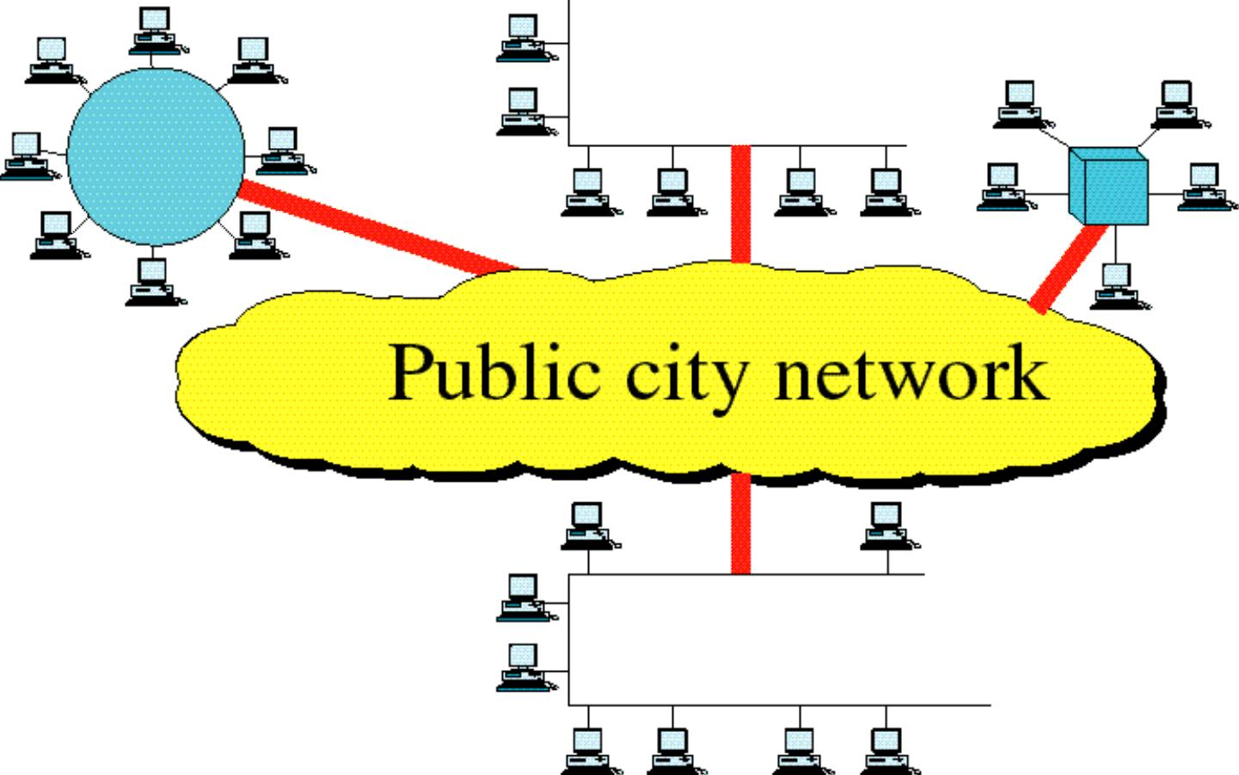
Metropolitan Area Network

Slide 10
Question
A university has campuses across a city. Each campus has its own LAN. What network type connects them for shared library resources?

Slide 11
Question
A university has campuses across a city. Each campus has its own LAN. What network type connects them for shared library resources?"
→ Answer: MAN

Slide 12
WIDE AREA NETWORK
Provides long distance transmission of data, voice, image and video information over large geographic areas that may comprise a country, a continent, or even the whole world.
Switched WAN:
connects the end systems, which usually comprise a router (internetworking connecting device) that connects to another LAN or WAN
complex as the backbones that connect the Internet.
Point-to-Point WAN:
A line leased from a telephone or cable TV provider that connects a home computer or a small LAN to an Internet service provider (lSP).
simple as a dial-up line that connects a home computer to the Internet

Slide 13
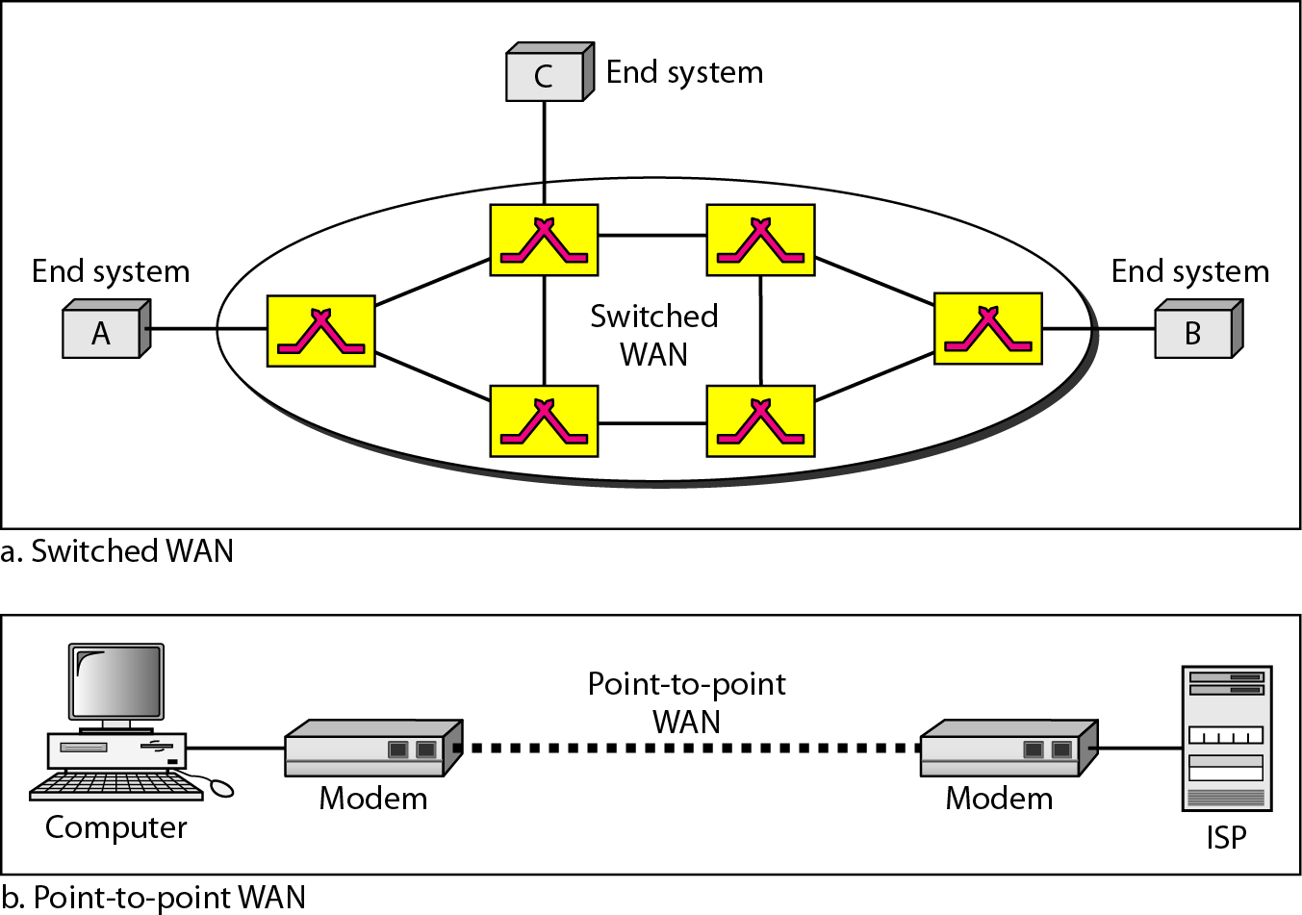
A Switched WAN & Point-to-Point WAN

Slide 14
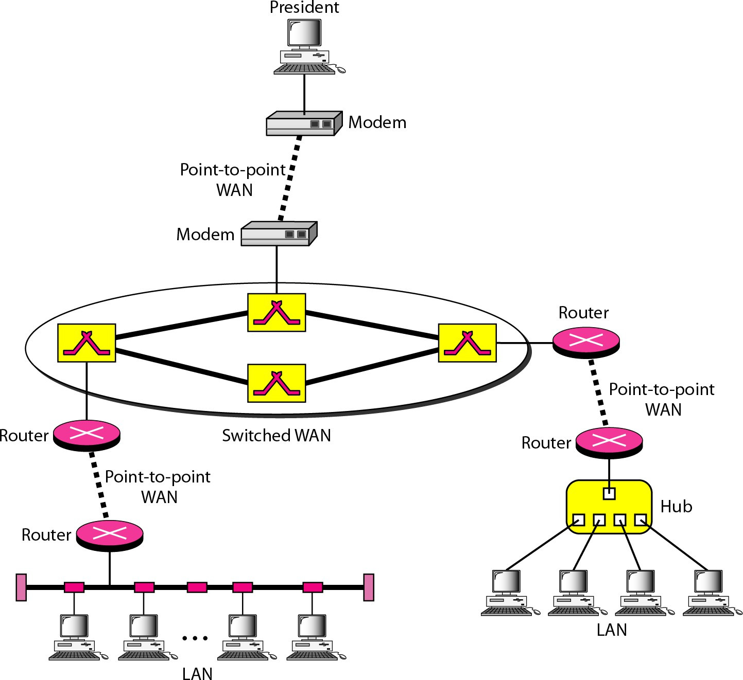
A Heterogeneous Network made of 4 WANs and 2 LANs

Slide 15
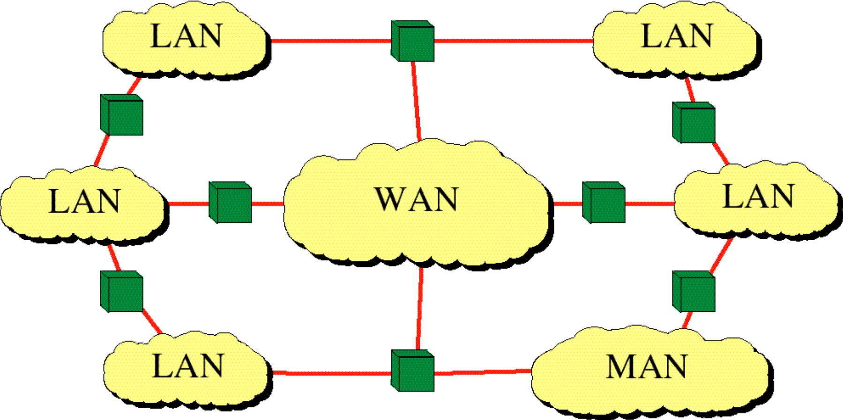
INTERNET

Slide 16
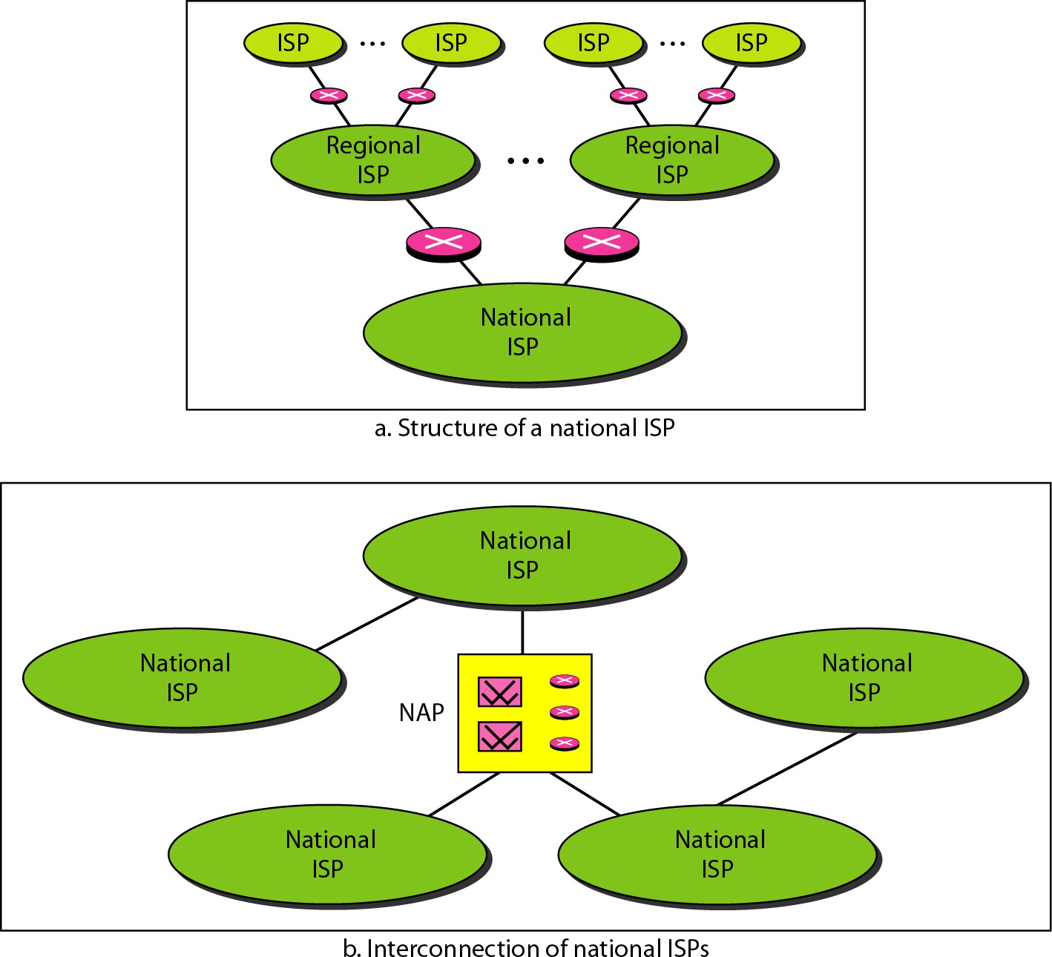
Hierarchical Organization of Internet

Slide 17
Question
Which WAN type uses routers to dynamically route traffic between multiple paths?

Slide 18
Question
Which WAN type uses routers to dynamically route traffic between multiple paths?
→ Answer: Switched WAN (distinguishes infrastructure complexity

Slide 19
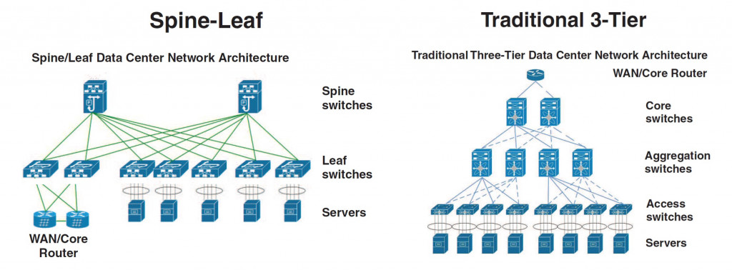

Slide 20
STANDARDS
Standard products
are necessary to ensure that from different manufacturers can
work together as expected.
Data Communication Standards fall in to two categories.
De facto
De jure

Slide 21
STANDARD ORGANIZATIONS
International Organization for Standardization (ISO)
International Telecommunication Union- Telecommunication Standards Sector (ITU-T)
American National Standards Institute (ANSI)
Institute of Electrical and Electronics Engineers (IEEE)
Electronics Industries Association (EIA)

Slide 22
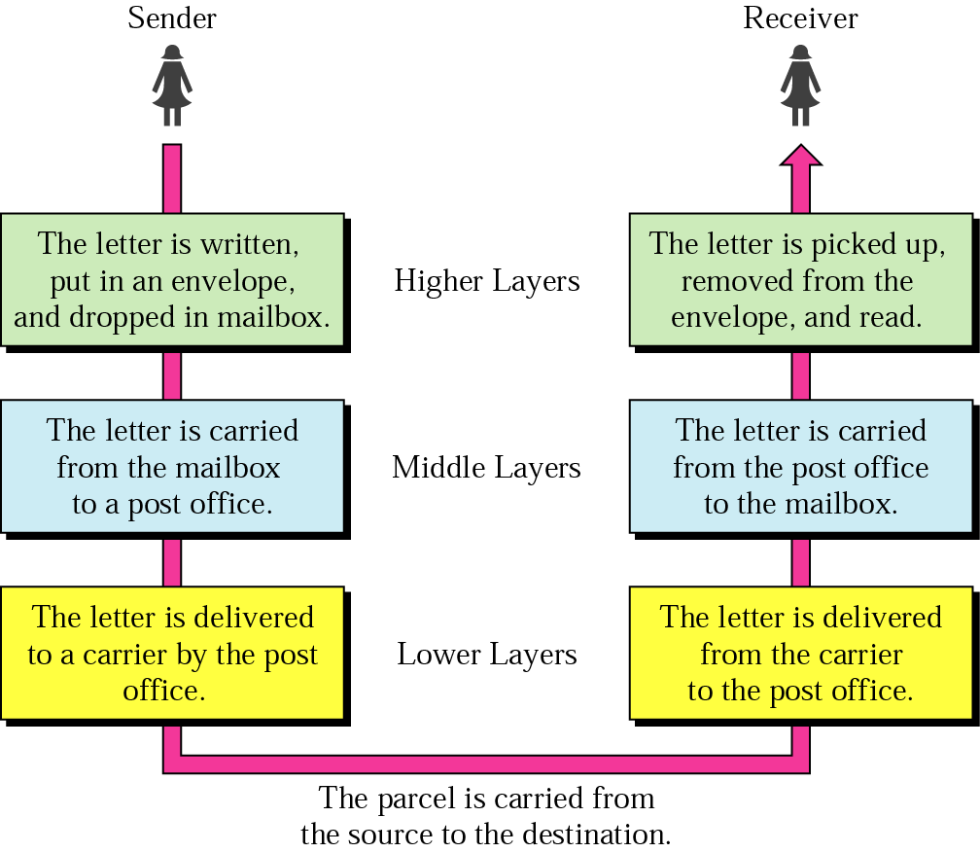
Layered Tasks
An example from the everyday life
Hierarchy?
Services

Slide 23
Why layered communication?
To reduce complexity of communication task by splitting it into several layered small tasks
Functionality of the layers can be changed as long as the service provided to the layer above stays unchanged
makes easier maintenance & updating
Each layer has its own task
Each layer has its own protocol

Slide 24
Reference Models
OSI reference model
TCP/IP

Slide 25
OSI Reference model
Open System Interconnection
7 layers
Crate a layer when different abstraction is needed
Each layer performs a well define function
Functions of the layers chosen taking internationally standardized protocols
Number of layers – large enough to avoid complexity

Slide 26
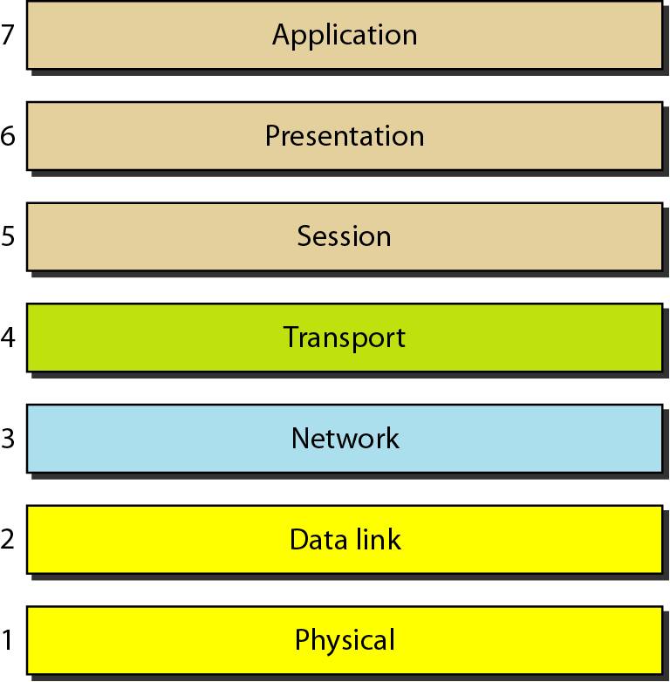
Seven layers of the OSI model

Slide 27
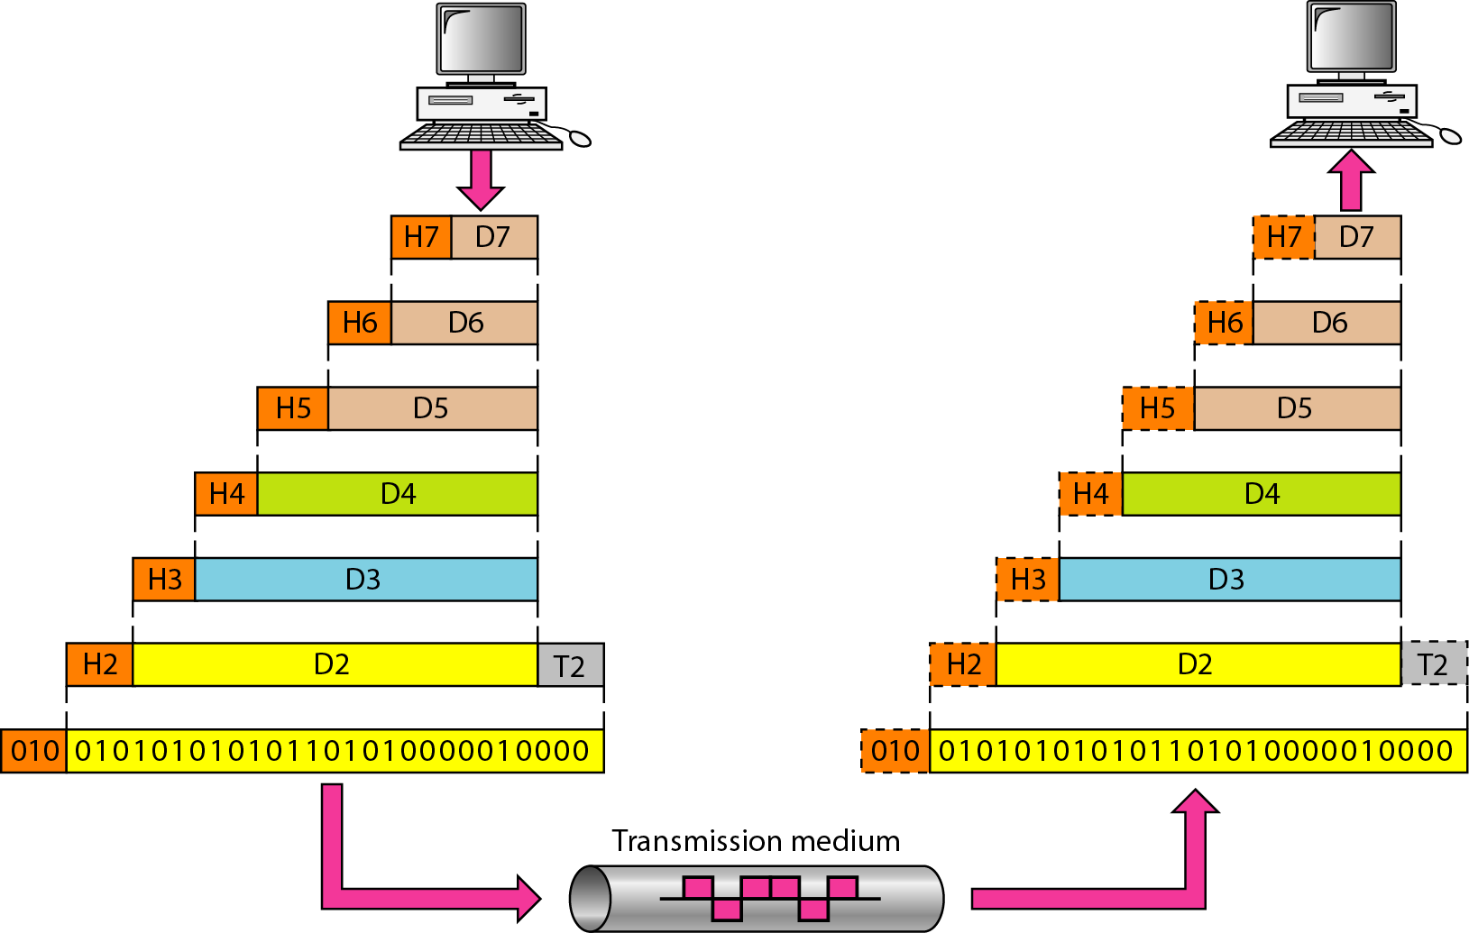
Exchange using OSI Model

Slide 28
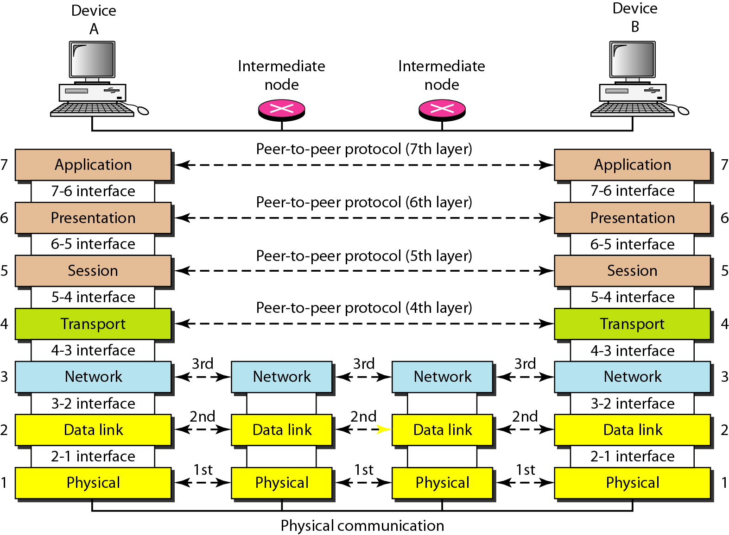
The interaction between layers in the OSI model

Slide 29
Issues, to be resolved by the layers
Larger bandwidth at lower cost
Error correction
Flow control
Addressing
Multiplexing
Naming
Congestion control
Mobility
Routing
Fragmentation
Security
....

Slide 30
OSI Layers

Slide 31
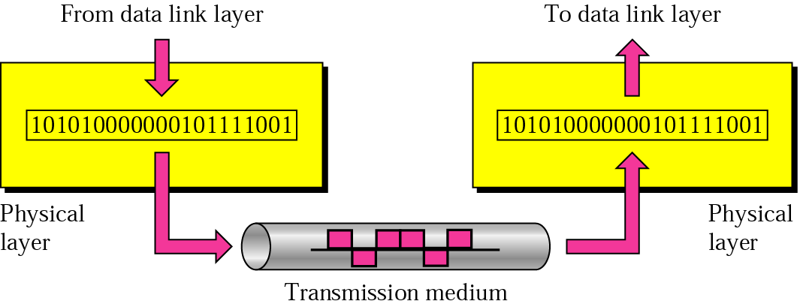
Physical layer
physical
connection
Transporting bits from one end node to the next
type of the transmission media (twisted-pair, coax, optical fiber, air)
bit representation (voltage levels of logical values)
data rate (speed)
synchronization of bits (time synchronization)

Slide 32

Note
The physical layer is responsible for movements of
individual bits from one hop (node) to the next.

Slide 33
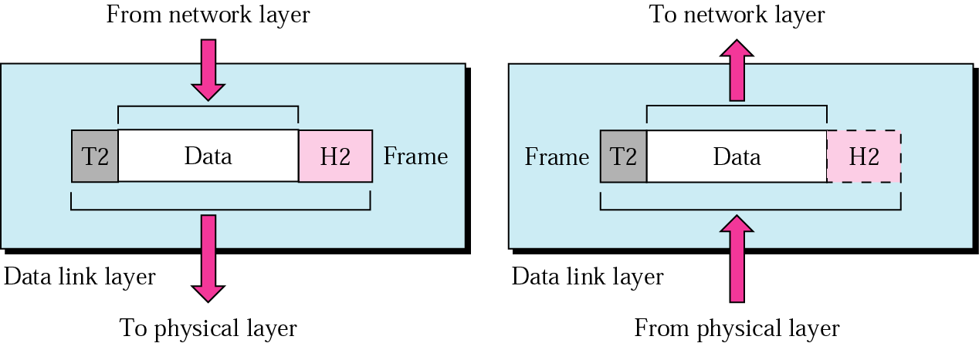
Data Link layer
logical
connection
Transporting frames from one end node to the next one
- framing - physical addressing
- flow control - error control
access control

Slide 34
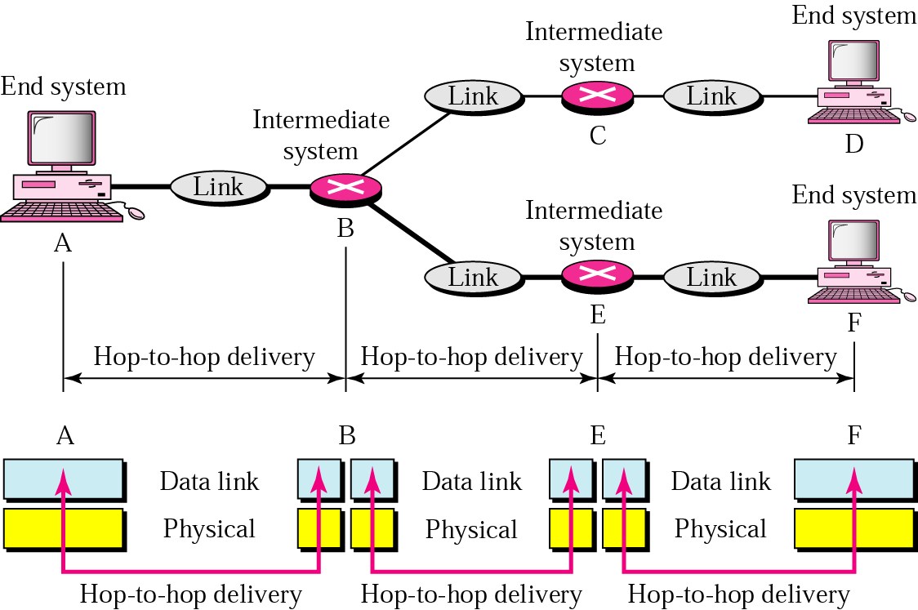
Data Link layer - hop-to-hop delivery-

Slide 35
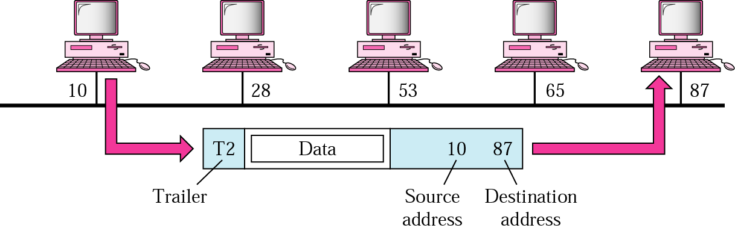
Data Link layer - example-

Slide 36
Note
The data link layer is responsible for moving frames from one hop (node) to the next.

Slide 37
Readings
Chapter 1 (B. A Forouzan)
Section 1.1, 1.2, 1.3,1.4
Chapter 2 (B.A Forouzan)
Section 2.1, 2.2

Slide 38


Slide 39
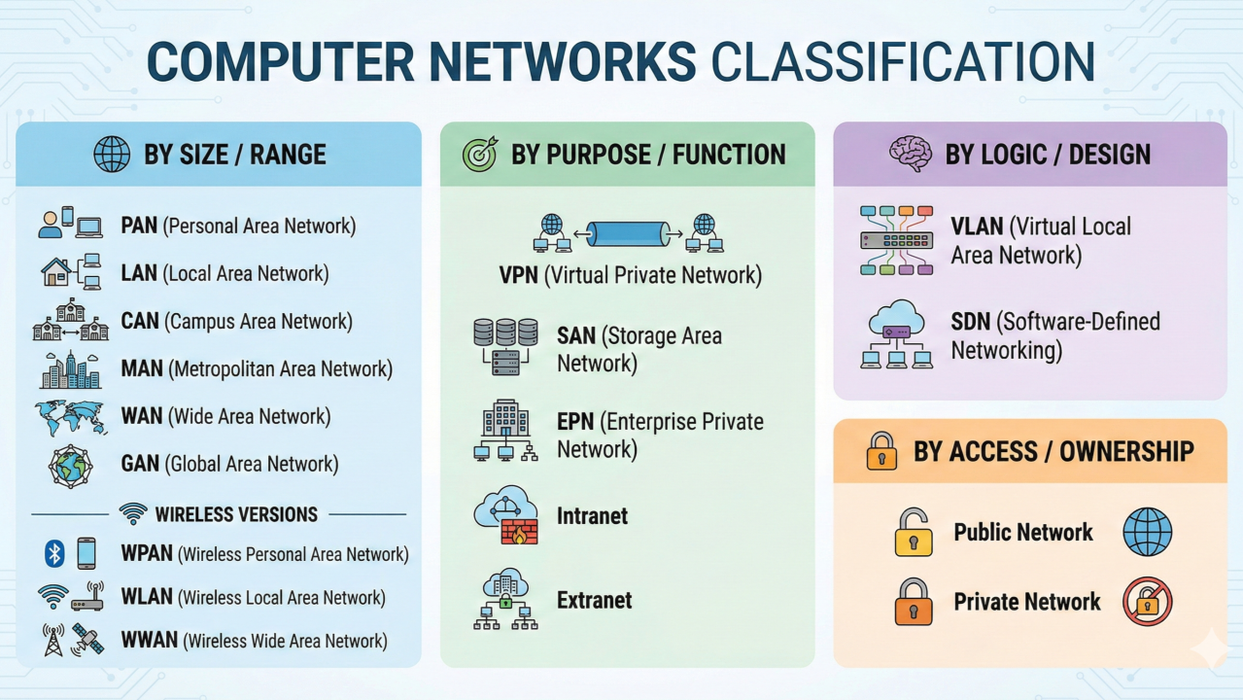

Slide 40
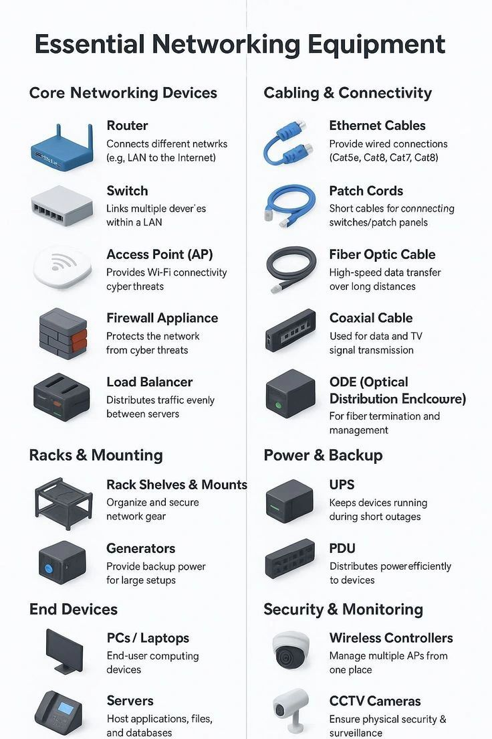

Slide 41
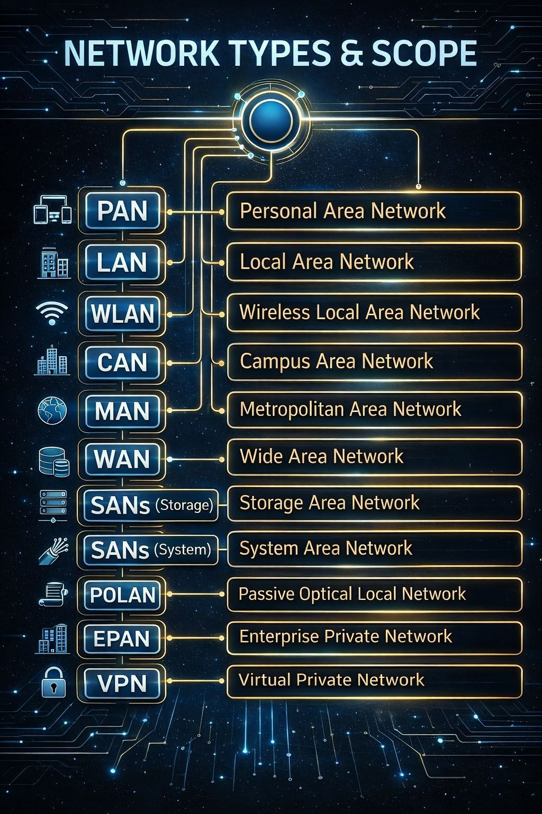

Slide 42
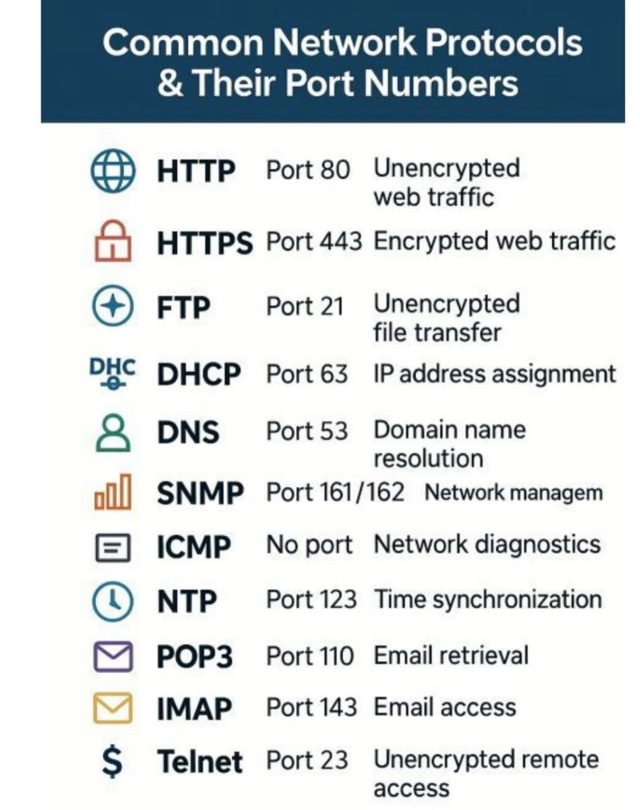

Slide 43
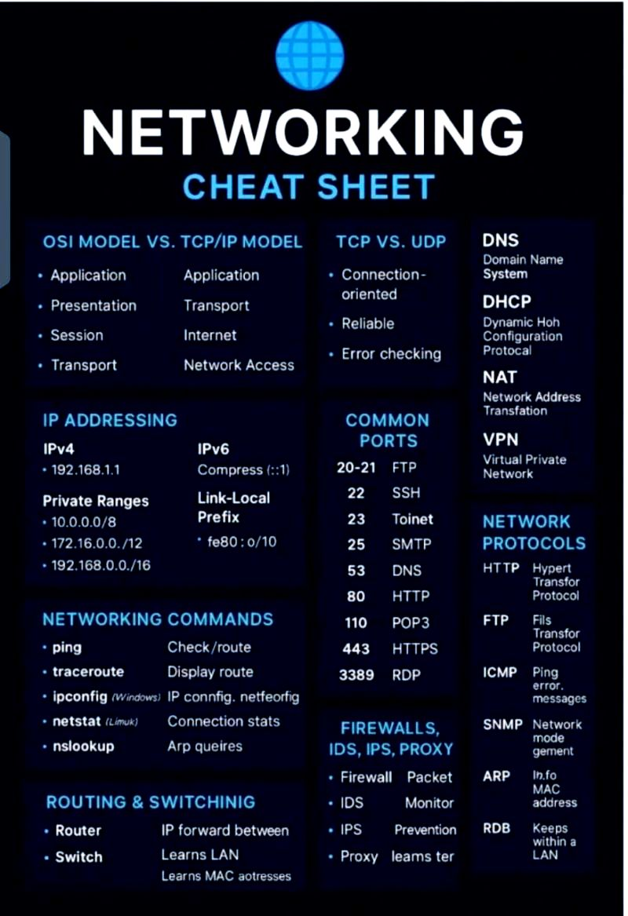

Slide 44
To-Do List
At least go through all the slides once in order to grasp the concept before the next lecture.
Join the Group Home page as soon as possible.
Lecture Slides for the next lecture will be uploaded on the group home page before the lecture.
Any concern regarding the course, email on the engr.ahmad.Nawaz@giki.edu.pk

